Slide 1
Languages and Compilers
(SProg og Oversættere)
Structure of the compiler

Slide 2
Structure of the compiler
Describe the phases of the compiler
Give an overall description of the purpose of each phase and how the phases interface
Explain b) in more detail using the ac language
Single pass vs. multi pass compiler
  Issues in language design
  Issues in code generation

Slide 3
The “Phases” of a Compiler
Source Program
Syntax Analysis
Error Reports
Abstract Syntax Tree
Contextual Analysis
Error Reports
Decorated Abstract Syntax Tree
Code Generation
Object Code

Slide 4
Different Phases of a Compiler
The different phases can be seen as different transformation steps to transform source code into object code.
The different phases correspond roughly to the different parts of the language specification:
Syntax analysis <-> Syntax
    Lexical analysis <-> Regular Expressions
    Parsing <-> Context Free Grammar
Contextual analysis <-> Contextual constraints
    Scope checking <-> Scope rules (static semantics)
    Type checking <-> Type rules (static semantics)
Code generation <-> Semantics (dynamic semantics)

Slide 5
An Informal Definition of the ac Language
ac: adding calculator
Types
  integer
  float: allows 5 fractional digits after the decimal point
  Automatic type conversion from integer to float
Keywords
  f: float
  i: integer
  p: print
Variables
  23 names from lowercase Roman alphabet except the three reserved keywords f, i, and p
Monolithic scope, i.e. names are visible in the program when they are declared (global)
  Note more complex languages may have nested scopes
    e.g. in C we can write { int x; … { int x; … x =5; … } … x =x +1; …}
Target of translation: dc (desk calculator)
  Reverse Polish notation (RPN)

Slide 6
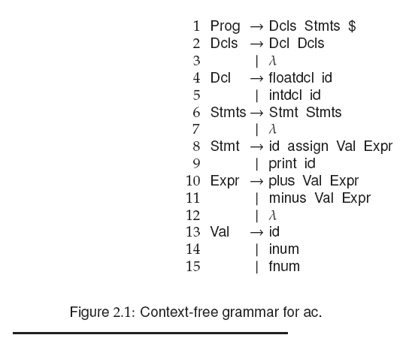
Syntax Specification
Notes:
Different tokens

Slide 7
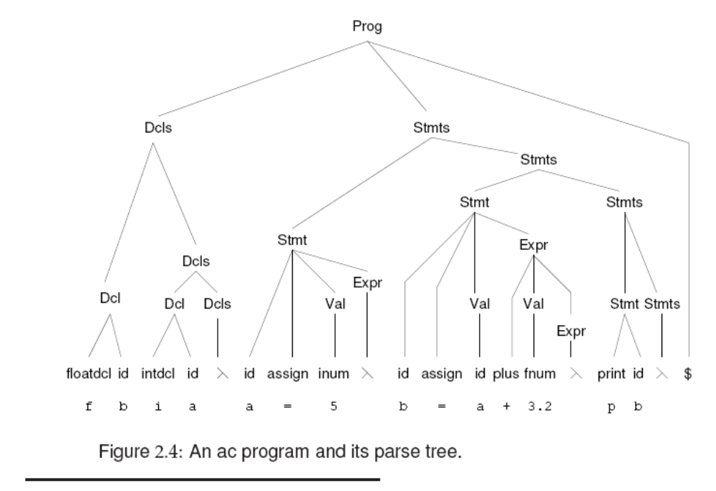

Slide 8
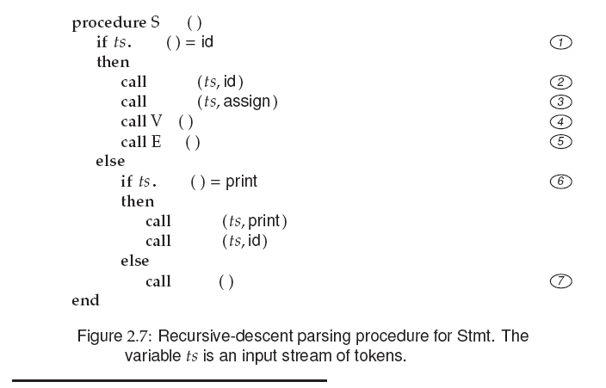
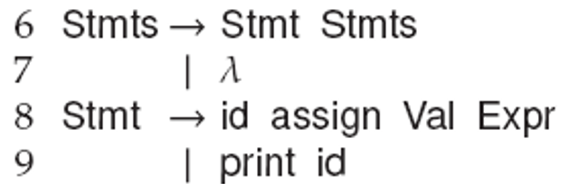
TMT
PEEK
    Stmt → id assign Val Expr
TMT
PEEK
MATCH
MATCH
MATCH
AL
MATCH
XPR
AL
XPR
PEEK
MATCH
    Stmt → print id
PEEK
MATCH
MATCH
ERROR
MATCH
ERROR

Slide 9
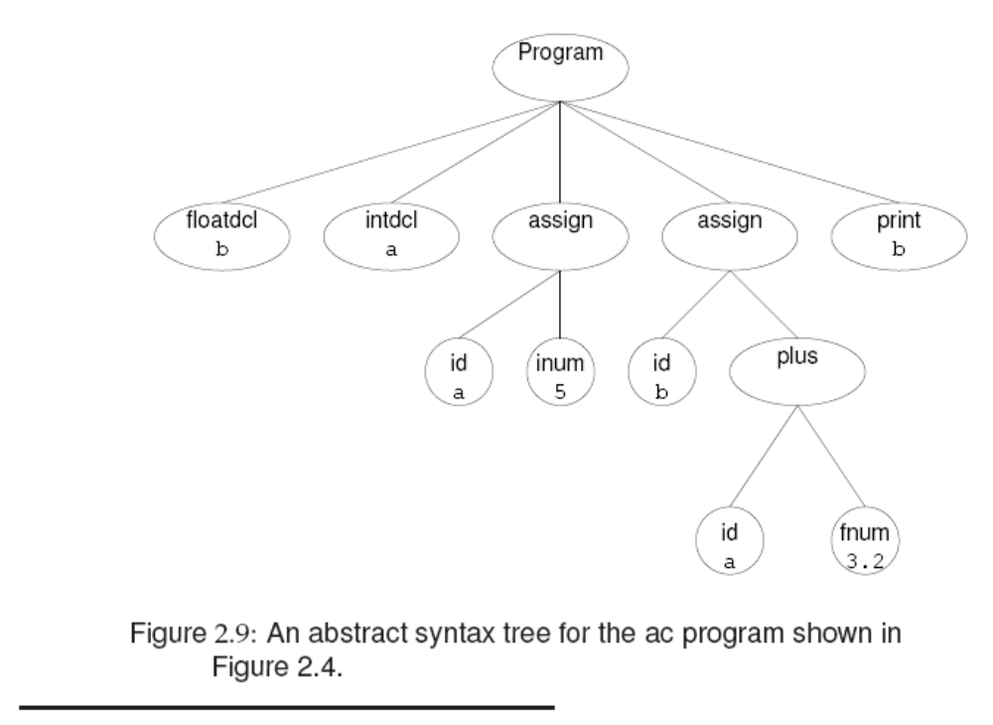

Slide 10
2) Contextual Analysis -> Decorated AST
Abstract Syntax Tree
Contextual Analysis
Error Reports
Decorated Abstract Syntax Tree
Contextual analysis:
  Scope checking: verify that all applied occurrences of identifiers are declared
  Type checking: verify that all operations in the program are used according to their type rules.
Annotate AST:
  Applied identifier occurrences => declaration
  Expressions => Type

Slide 11
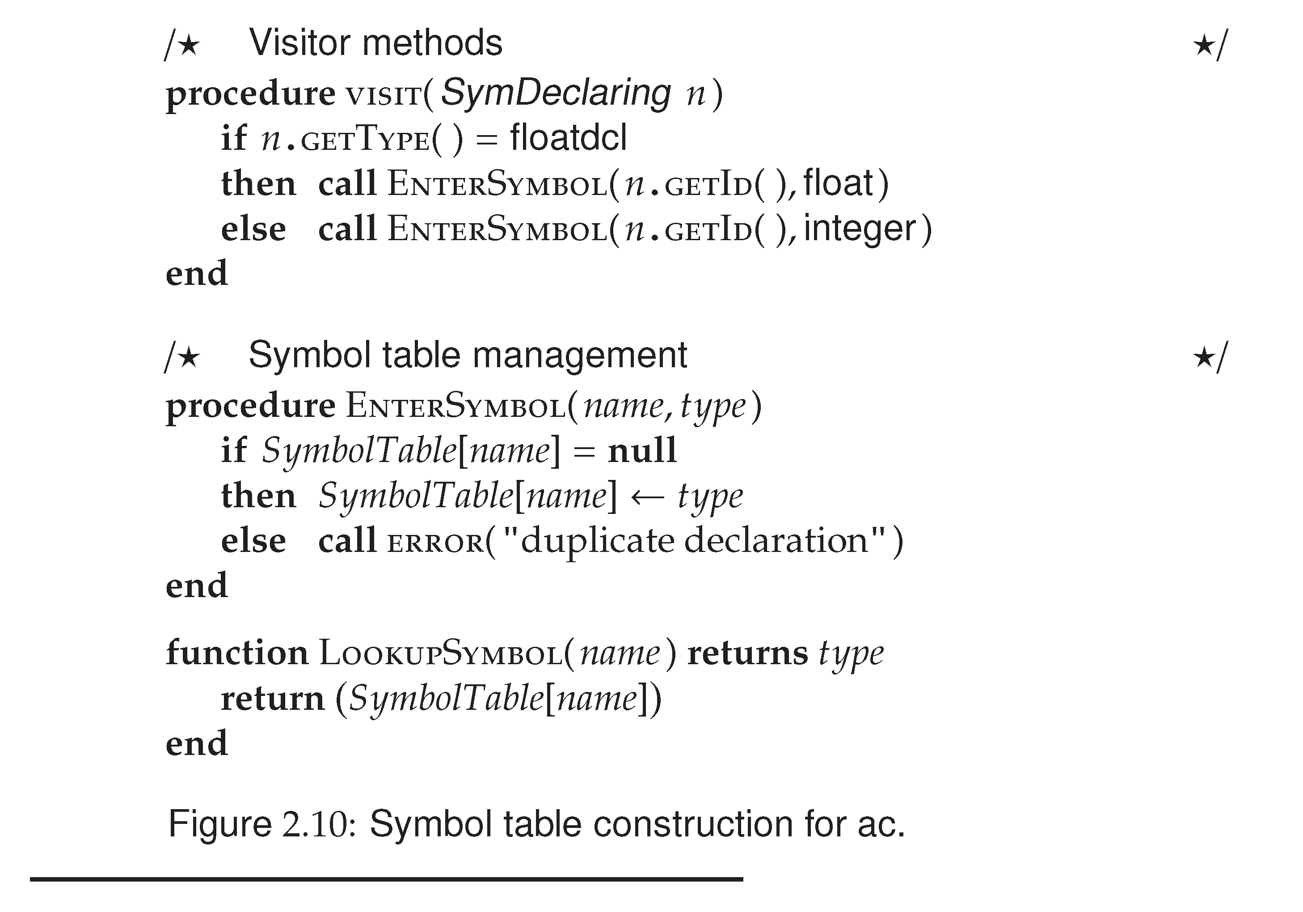

Slide 12
Type Checking
Only two types in ac
  Integer
  Float
Type hierarchy
  Float wider than integer
  Automatic widening (or casting)
    integer -> float
All identifiers must be type-declared in a program before they can be used
This process walks the AST bottom-up from its leaves toward its root.

Slide 14
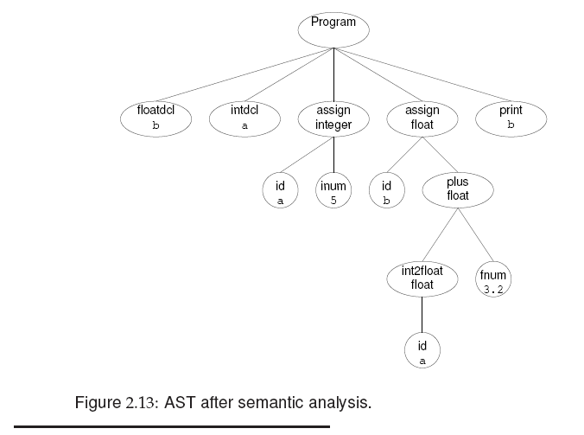

Slide 15
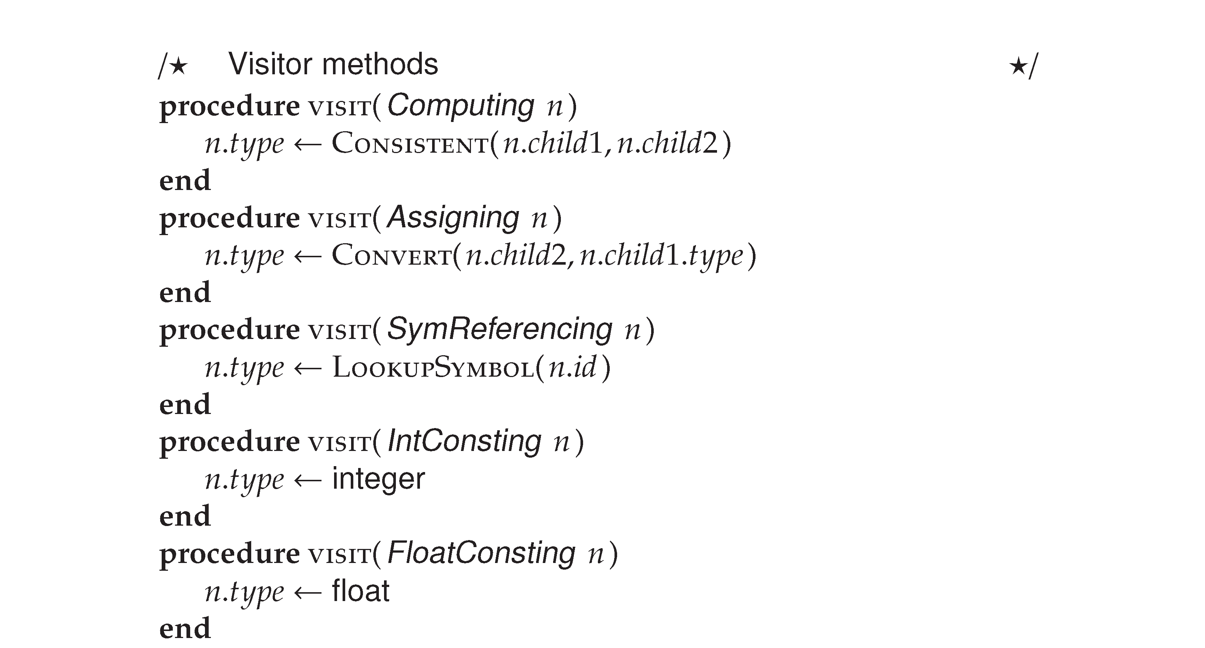
Type Checking

Slide 16
3) Code Generation
Decorated Abstract Syntax Tree
Code Generation
Object Code
Assumes that program has been thoroughly checked and is well formed (scope & type rules)
Takes into account semantics of the source language as well as the target language.
Transforms source program into target code.

Slide 17
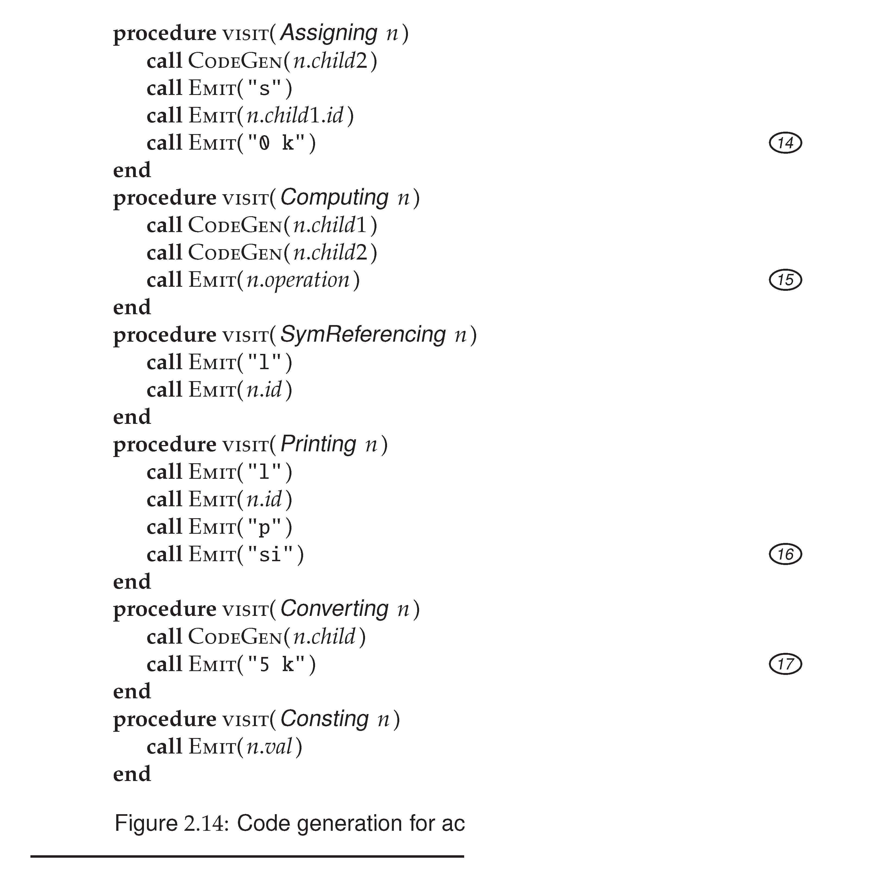

Slide 18
An Example ac Program
Example ac program:
  f b
  i a
  a = 5
  b = a + 3.2
  p b
  $
Corresponding dc code
  5
  sa
  la
  3.2
  +
  sb
  lb
  p

Slide 19
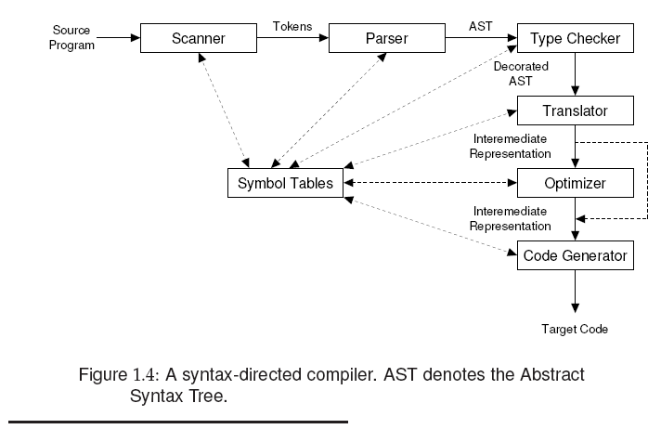
Organization of a Compiler

Slide 20
Implementing Tree Traversal
“Traditional” OO approach
Visitor approach
  GOF
  Using static overloading
  Reflective
  (dynamic)
  (SableCC style)
“Functional” approach
Active patterns in Scala (or F#)
(Aspect oriented approach)
Notes:
OO = composite
GOF = gang of four (Navn i visit fx visit+ ….) fx visitPlus(PlusNode node)

Slide 21
Multi Pass Compiler
A multi pass compiler makes several passes over the program. The output of a preceding phase is stored in a data structure and used by subsequent phases.
Dependency diagram of a typical Multi Pass Compiler:
Compiler Driver
calls
calls
calls
Syntactic Analyzer
Contextual Analyzer
Code Generator
input
input
input
output
output
output
Source Text
AST
Decorated AST
Object Code

Slide 22
Single Pass Compiler
A single pass compiler makes a single pass over the source text, parsing, analyzing and generating code all at once.
Dependency diagram of a typical Single Pass Compiler:
Compiler Driver
calls
Syntactic Analyzer
calls
calls
Contextual Analyzer
Code Generator

Slide 23
Compiler Design Issues
Single Pass
Multi Pass
Speed
Memory
Modularity
Flexibility
“Global” optimization
Source Language
better
worse
better for
large programs
(potentially) better for small programs
worse
better
worse
better
impossible
possible
single pass compilers are not possible for many programming languages
Notes:
Single pass = går kun igennem det en gang, så den emitter lige efter parser fx
Multi parse skal måske holde mindre memory på en gang i modsætning til single pass som skal holde styr på det hele på en gang.

Slide 24
Language Issues
Example Pascal:
Pascal was explicitly designed to be easy to implement with a single pass compiler:
  Every identifier must be declared before it is first use.
?
var n:integer;
procedure inc;
begin
n:=n+1
end
procedure inc;
begin
n:=n+1
end;
var n:integer;
Undeclared Variable!

Slide 25
Language Issues
Example Pascal:
  Every identifier must be declared before it is used.
  How to handle mutual recursion then?
procedure ping(x:integer)
begin
... pong(x-1); ...
end;
procedure pong(x:integer)
begin
... ping(x); ...
end;

Slide 26
Language Issues
Example Pascal:
  Every identifier must be declared before it is used.
  How to handle mutual recursion then?
forward procedure pong(x:integer)
procedure ping(x:integer)
begin
... pong(x-1); ...
end;
procedure pong(x:integer)
begin
... ping(x); ...
end;
OK!

Slide 27
Language Issues
Example Java:
  identifiers can be declared before they are used.
  thus a Java compiler need at least two passes
Class Example {
void inc() { n = n + 1; }
int n;
void use() { n = 0 ; inc(); }
}

Slide 28
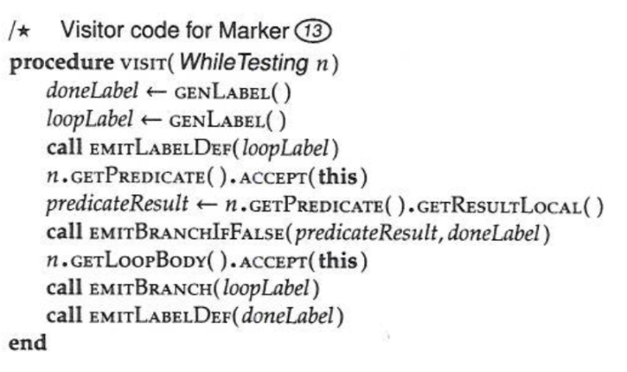
Code Templates
While Command:
visit [while E do C] =
  l: visit [E]
  JUMPIFFALSE d
  visit[C]
  JUMP l
  d:
E
C
Alternative While Command code template:
visit [while E do C] =
  JUMP h
  l: visit [C]
  h: visit[E]
  JUMPIFTRUE l
C
E

